Slide 1
On the similarity and challenges of multiresonant and iterative learning current controllers for grid converters and why the disturbance feedforward matters
Bartlomiej UFNALSKI, D.Sc., prof. of WUT
7 December 2017, Toruń
Czwartkowe Kolokwium Fizyczne
UMK

Slide 2
Outline
Repetitive processes
Internal model principle (IMP)
Resonant/multioscillatory controller
Iterative learning controller
Do they introduce identical generating polynomial?
Periodic disturbance feedforward in the context of repetitive control
Cons and pros – a not so definitive comparison

Slide 3
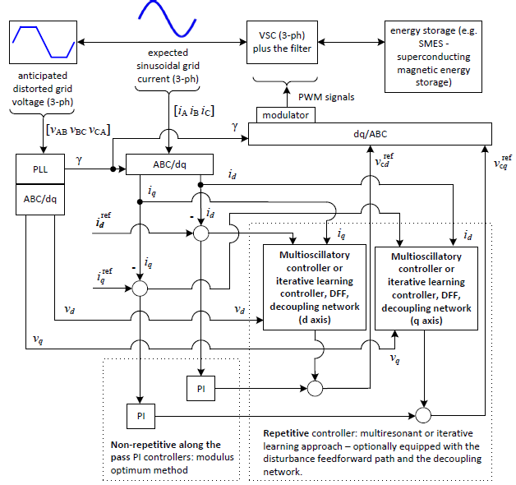
Grid-tie converter

Slide 4


Superconducting Magnetic Energy Storage

Slide 5






Internal model principle
Asymptotic stability:
Asymptotic tracking:

Slide 6



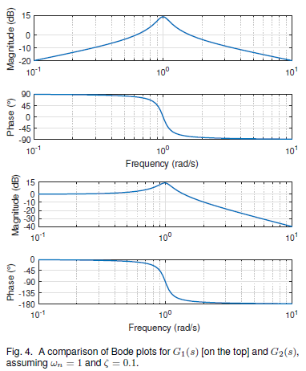
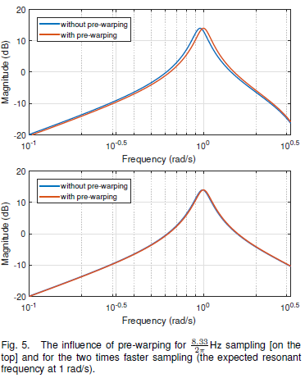


Resonant/multioscillatory controller (MOSC)
Pre-warping:
Tustin’s:

Slide 7
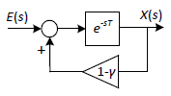

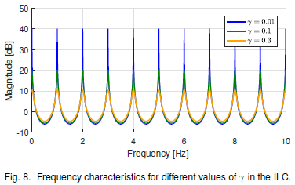
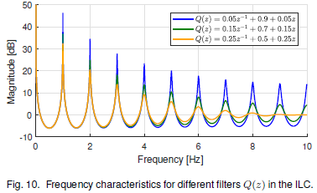
Iterative learning controller (ILC)

Slide 8
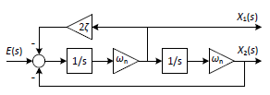






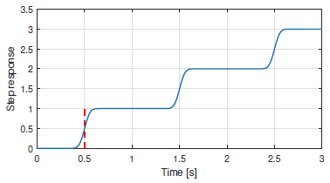

Generating polynomial(s?)
Identical generating polynomials!!!

Slide 9
Grid-tie converter

Slide 10





Periodic disturbance feedforward (DFF)
Plant in dq:
Ideal DFF in dq:
Real-life DFF
supported with MOSC in dq:

Slide 11
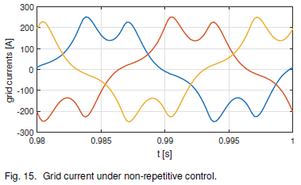
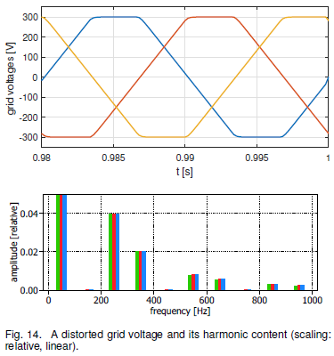
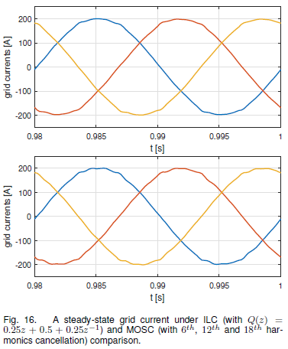
Simulation results

Slide 12
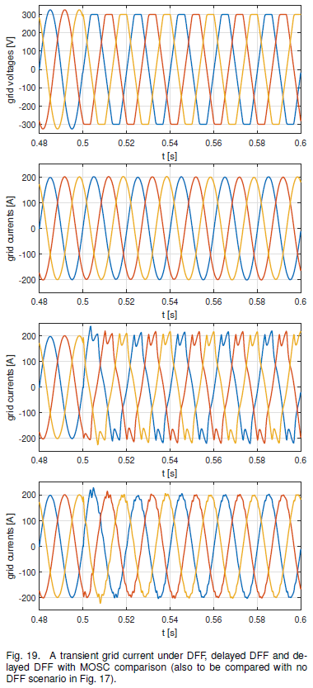
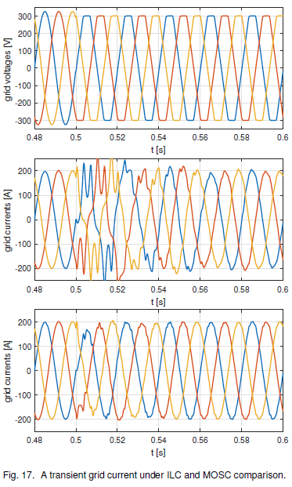
Simulation results (cont.)

Slide 13
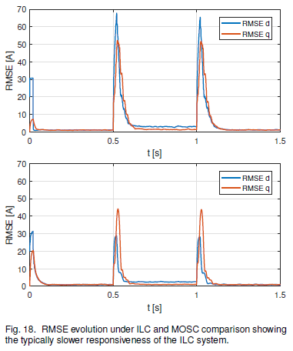
Simulation results (cont.)

Slide 14
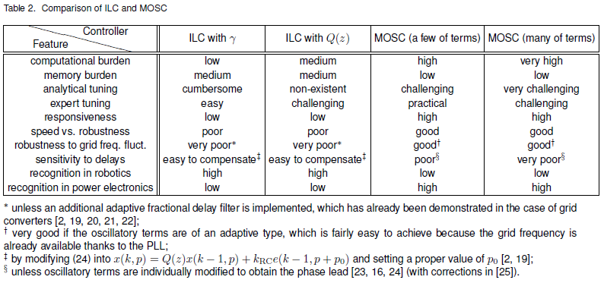
Pros and cons

Slide 15
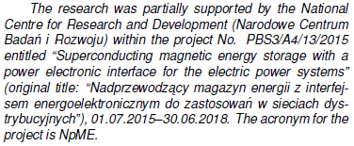

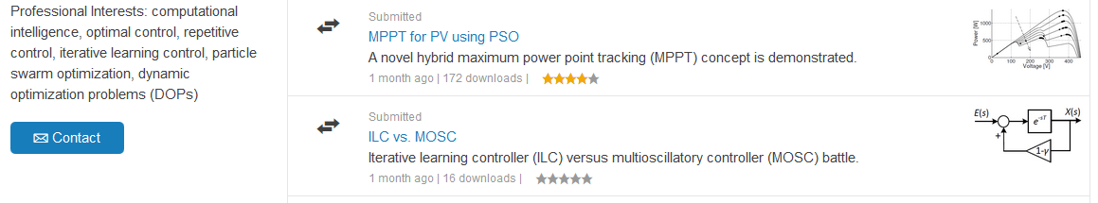
Thank you for having me!

Slide 16
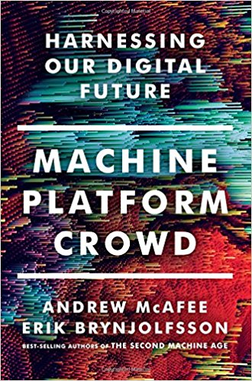
What’s next?

